Slide 1
DevOps Project Simulation
School Schedule

Slide 2
Description of Roles
Roles | Responsibilities | Name
Team Lead | Overall in-charge of the project | cris.gievid.m.narca
CI/CD | In-charge of Configuration of Tools | anjhillian.s.cabrera, mari.cris.p.ayes
Developer | In-charge of the Development of Application that will be use | mari.cris.p.ayes, joey.ann.o.robles
Document – Writer | In-charge of Documenting the whole project | pauleen.s.pineda

Slide 3
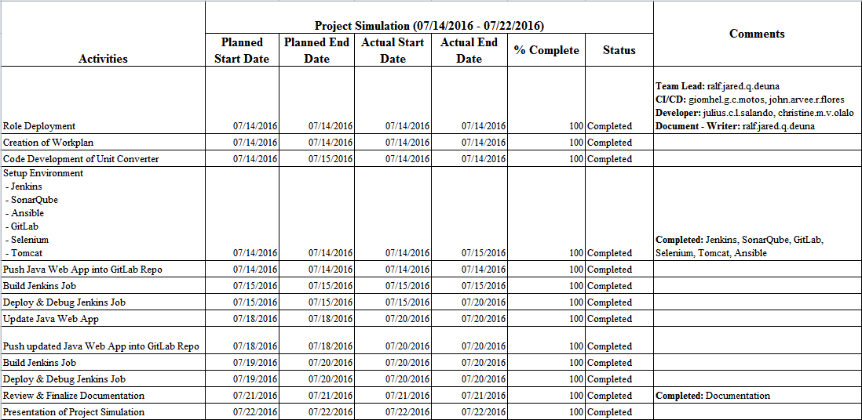

Slide 4
What is DevOps?
Dev
Ops
DevOps

Slide 5
Introduction
Development Operations (DevOps) can be described as the overall practice of automating the process of software delivery and infrastructure changes
Different tools are integrated to ensure that projects are completely and correctly done in the entire service lifecycle, from design through the development process to production support

Slide 6
Overview of Tools
Amazon Web Services (AWS)
GitLab
Jenkins
Maven
SonarQube
Ansible
Tomcat
Selenium

Slide 7

Amazon Web Services (AWS) is a cloud services platform
It provides a broad set of infrastructure services, such as computing power, storage options, networking and databases, delivered as a utility: on-demand, available in seconds, with pay-as-you-go pricing

Slide 8

GitLab is an application to code, test, and deploy code together
It provides Git repository management with fine grained access controls, code reviews, issue tracking, activity feeds, wikis, and continuous integration
It is a remote repository where you can create projects of different sizes with speed and efficiency

Slide 9

Jenkins is an open source continuous integration tool written in Java
It is a server-based system running in a servlet container such as Apache Tomcat

Slide 10

Apache Maven is a software project management and comprehension tool
Based on the concept of a project object model (POM), Maven can manage a project's build, reporting and documentation from a central piece of information

Slide 11

SonarQube is an open source tool used to measure and analyze code quality
It is written in Java but is able to analyze code in many languages

Slide 12
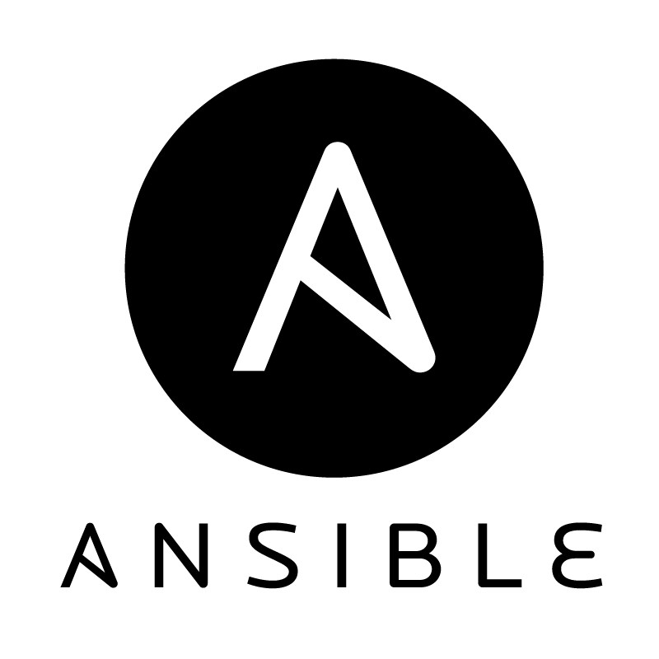
Ansible is a software platform for managing and combining multi node software deployment, as well as ad-hoc changes in the execution and configuration management of a system
It is designed for multi-tier deployments

Slide 13

Apache Tomcat, often referred to as Tomcat, is an open-source web server developed by the Apache Software Foundation (ASF)
Tomcat implements several Java EE specifications including Java Servlet, JavaServer Pages (JSP), Java EL, and WebSocket, and provides a "pure Java" HTTP web server environment in which Java code can run

Slide 14
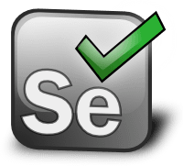
Selenium is a free (open source) automated testing suite for web applications across different browsers and platforms
It is quite similar to HP Quick Test Pro (QTP) only that Selenium focuses on automating web-based applications

Slide 15
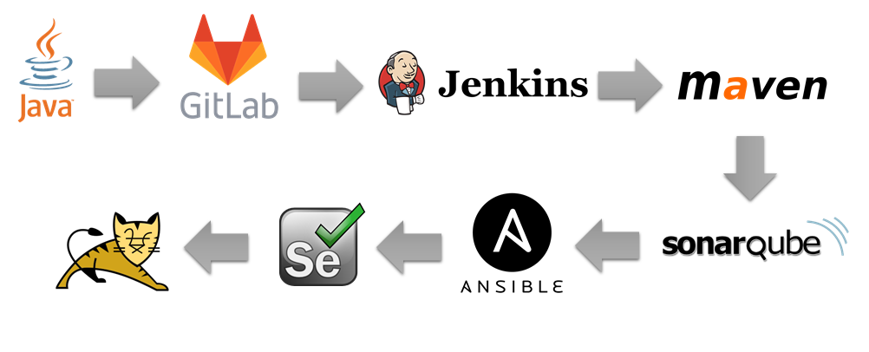
Process

Slide 16
DEMO
Unit Converter

